Slide 1
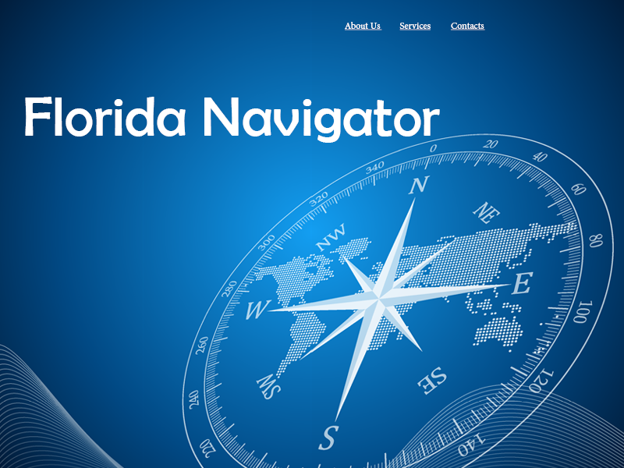
flnavigator.org
Meghan Murray
Agency for Persons with Disabilities

Slide 2
What is the Florida Navigator?
A web-based tool designed to assist users in researching information on state government disability programs and services
Information shared include programs and services from:
Agency for Health Care Administration
Agency for Persons with Disabilities
Department of Children and Families
Department of Education
Department of Elder Affairs
Department of Health
Department of Transportation

Slide 3
Why Create the Navigator?
To better streamline the search for state services with consolidated information in one place
To provide information in a format that is not overwhelming to users
To sort information by life stages:
Early Years: Birth to 3 years of age, or before the child enters the education system
School Years: Ages 4-21
Work and Family Years: Ages 22-59
Retirement Years: Ages 60+

Slide 4
How Does the Navigator Differ from Resource Directory?
Search results are specific to state services only
Small and separate to empower users without overwhelming
Navigates users to the agency
Search results provide eligibility requirements, contact information, and a direct link to program’s web page for additional information
Offers a connection with the Family Care Councils

Slide 5
The Florida Navigator
www.flnavigator.org
Community Resource Directory
www.apdcares.org/resourcedirectory

